Slide 1


Scariest
Movie
by: Amber McClurg

Slide 2

About the creator
•2020 BroadbandChoices.co.uk founded the Science of Scare Project
•This site compares deals for TV viewing and cell phone usage by sorting through hundreds and thousands of deals.

Slide 3
The data behind the scare 2020
The study found 50 of the best horror films
Each movie was watched in 5.1 sound
50 people watched over 120 hours

Slide 4


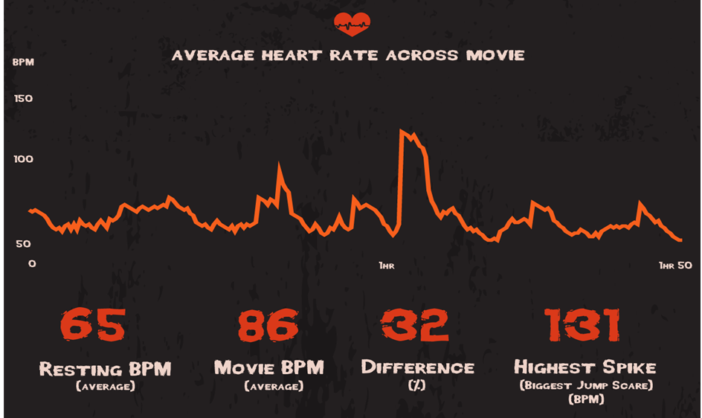

Slide 5
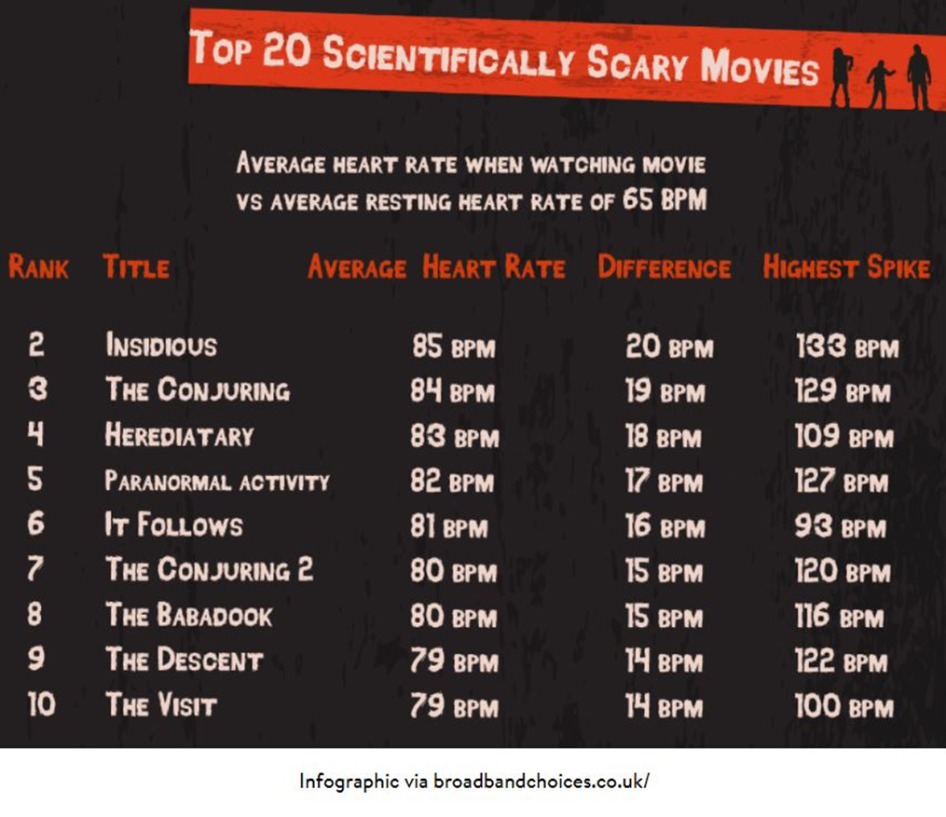

Slide 6


The study found 40 of the world’s scariest horror movies
Through 18 months of Reddit recommendations and critics list
250 participates
Fitted with heart rate monitors
The data behind the scare 2021

Slide 7

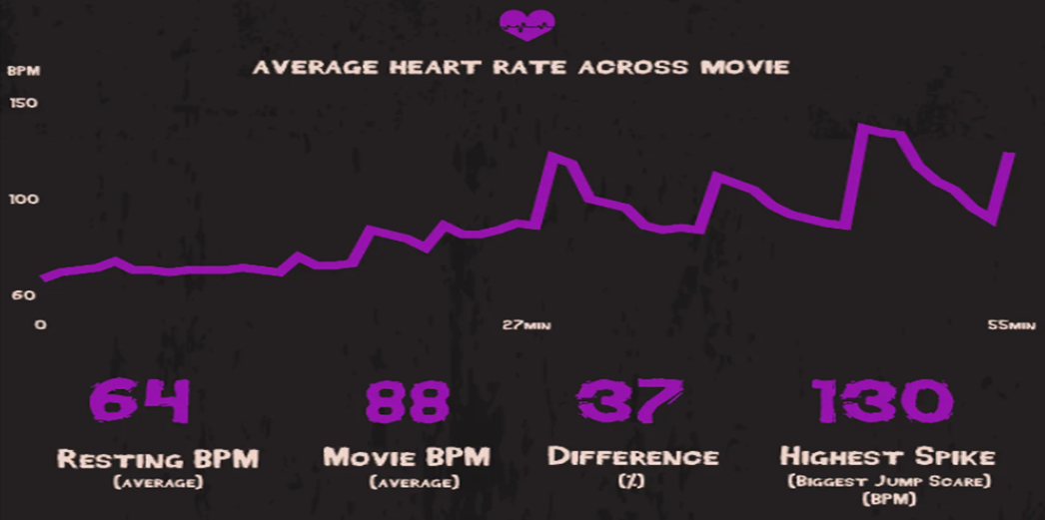

Slide 8
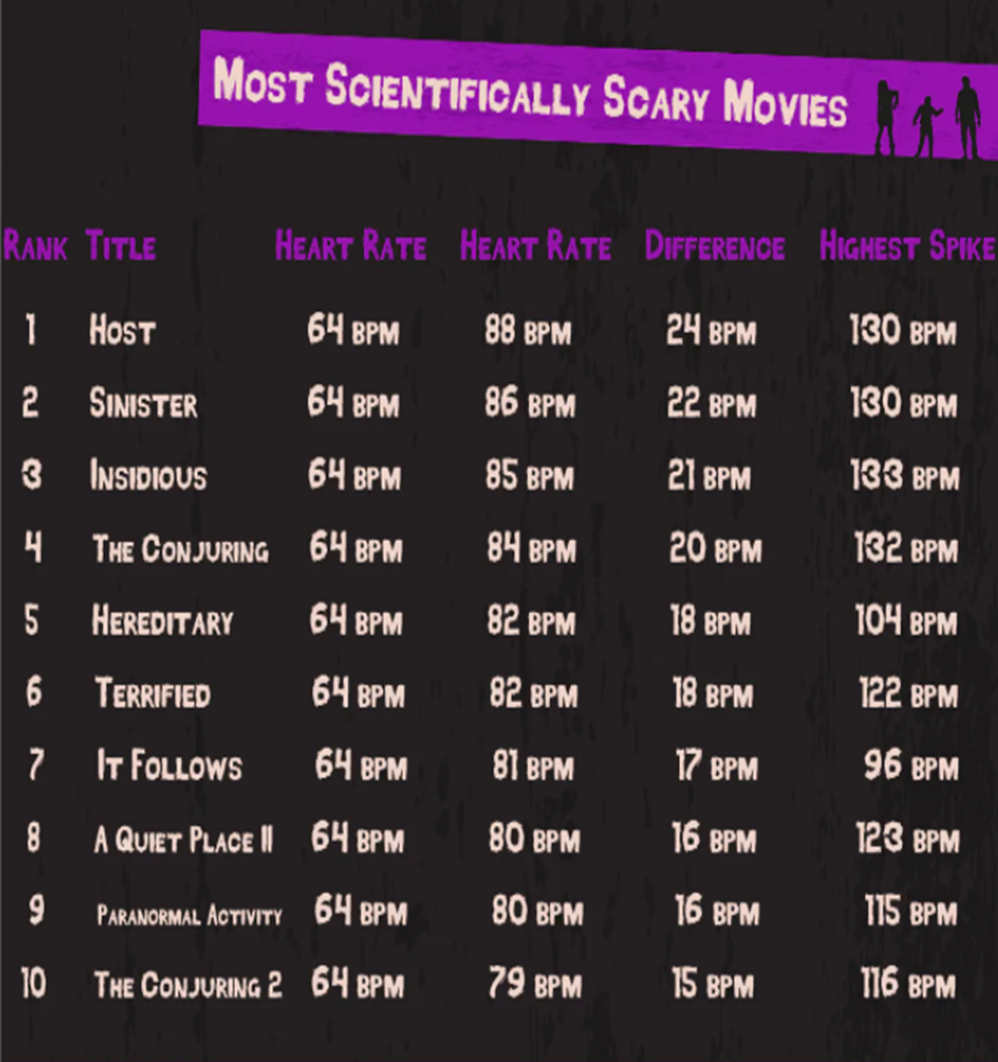
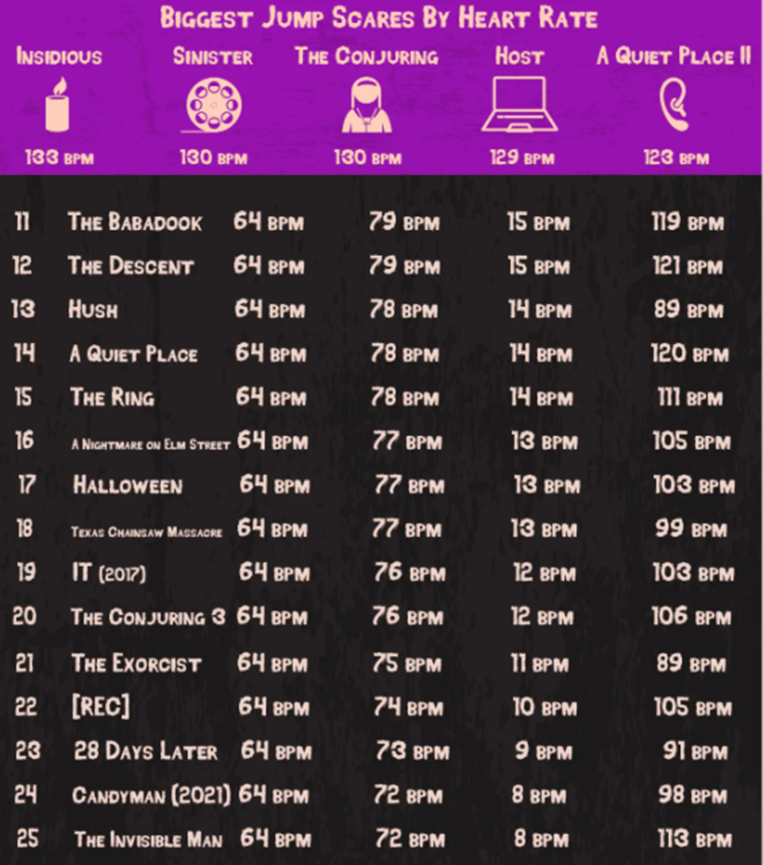

Slide 9
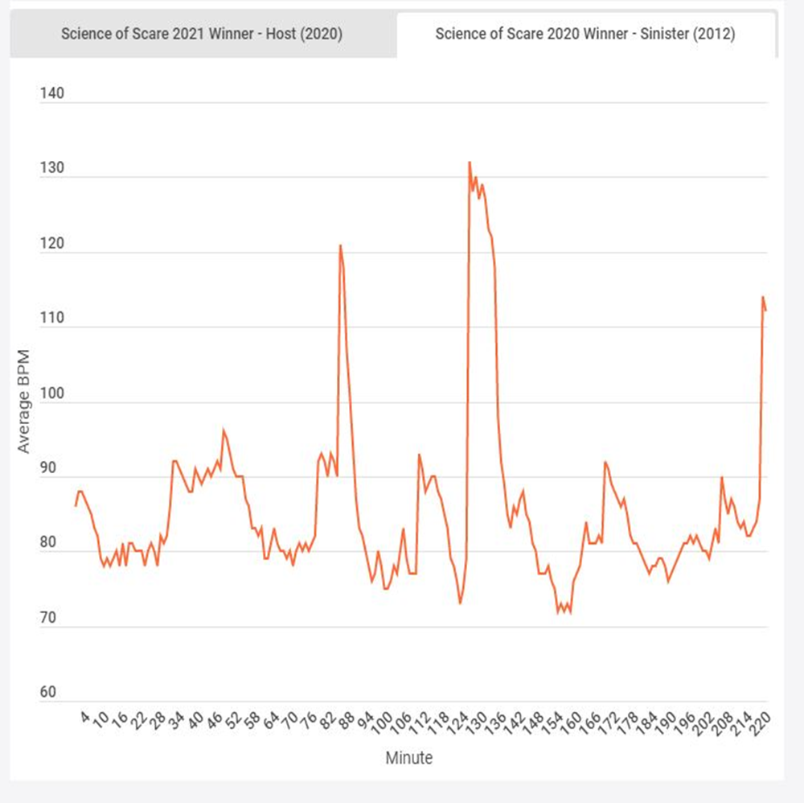
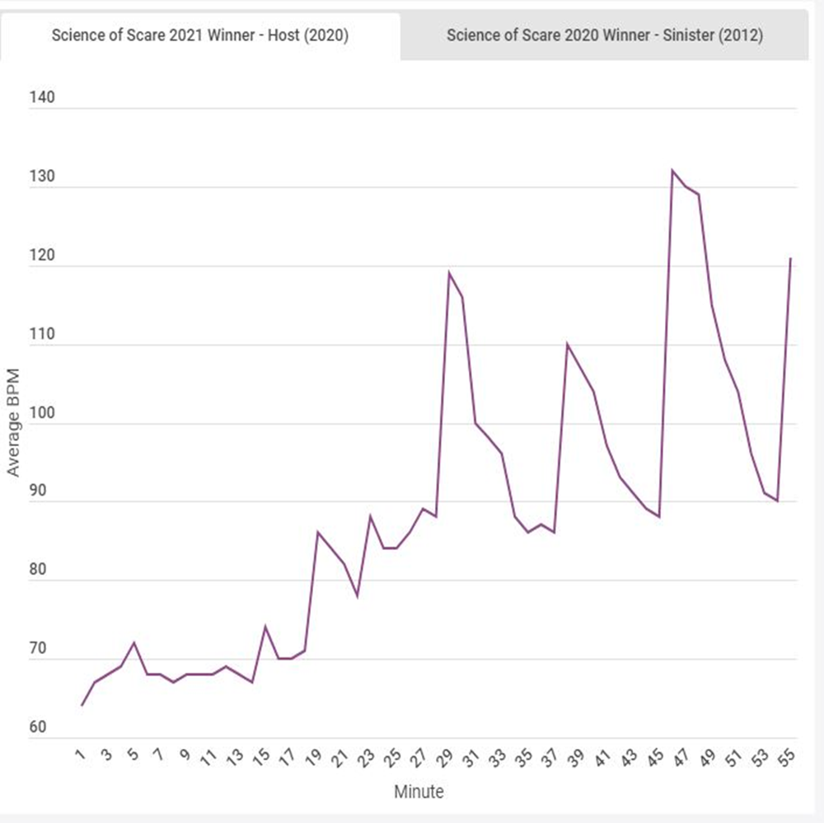


Slide 10

Citations
Leggett J. (2020, October 12) The scariest movies - according to Science! 2021 Update Online: broadbandchoices.co.uk
Infogram (2021) Science of Scare winner 2020-2021. Online: infogram.com
Infogram (2021) Full result Science of Scare 2020-2021. Online: infogram.com

